Slide 1
Design Sprint
Amir Dirin

Slide 2
Today Schedule (19.01.2023)
13:00 | Reforming the teams
13.30 | Continue the overview of the Design sprint Continue with the Design sprint day 1
14.30 - | Do the items 14-13 on its checklist of Design sprint day 1 Do the assignment in Oma: Make a Map as instructed in the Day 1 Design sprint Checklist item 12.

Slide 3
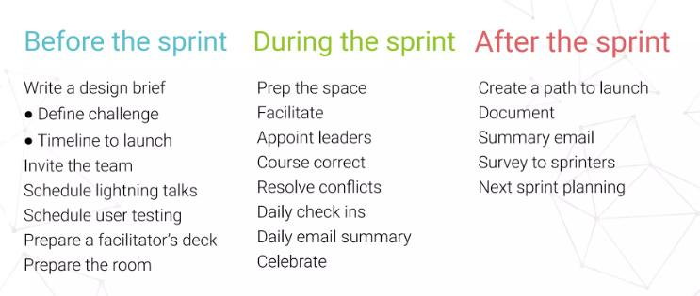
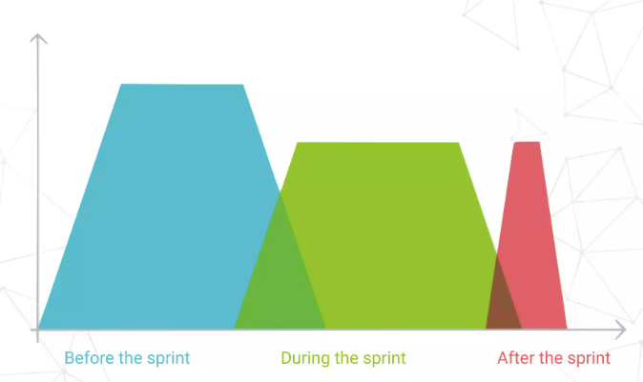
Design Sprint

Slide 4
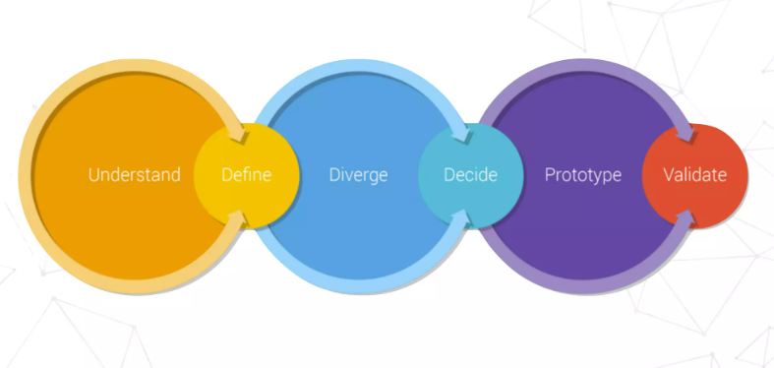
Google design sprint
Validate:
Test the ideas with users, business stakeholders and technical experts
User test
Stakeholder feedback
Technical Feasibility
Define:
What is the key strategy and focus
Create a simple user story, set the scope for the week, and take a useful notes as a team
User Journeys
Design principles
First Tweet
Decide:
Select the best ideas so far.
Vote for the best design
Understand:
What are the user needs, business need and technology capacities. Business goals, technology, and user research
User Interviews
Visiting users in the field where the product is used
Stakeholder map
Competitive overview
Summarize the learnings
Share your thoughts
Group ideas.
Vote on the best ideas
Diverge:
How might we explore as many ideas as possible?
Notes
Mind Map
Crazy 8s,
Storyboard
See how different stakeholders (CEO, engineers and sales) may contribute their ideas.
Prototype:
Create an artifact that allows to test the ideas with users
Mockup
Demos
Videos
Physical Prototype
8 ideas in 5 minutes
1 idea in 5 minutes (learn the details better)
1 storyboard in 5 minute (Understanding the steps)

Slide 5
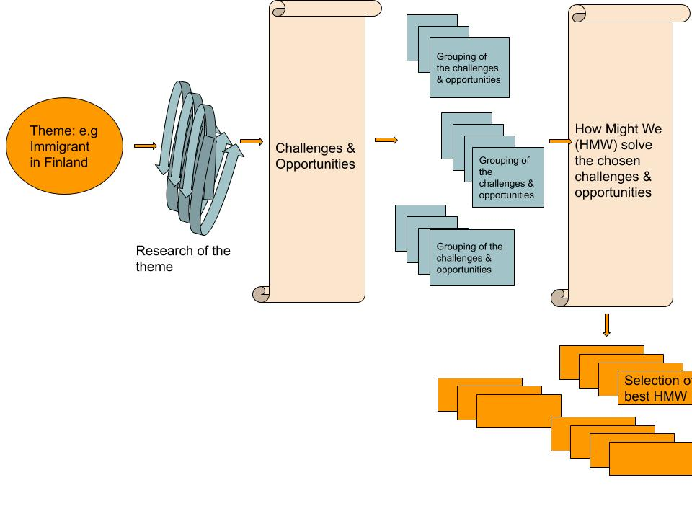
Day 1: Set the stage & Define the challenge

Slide 6
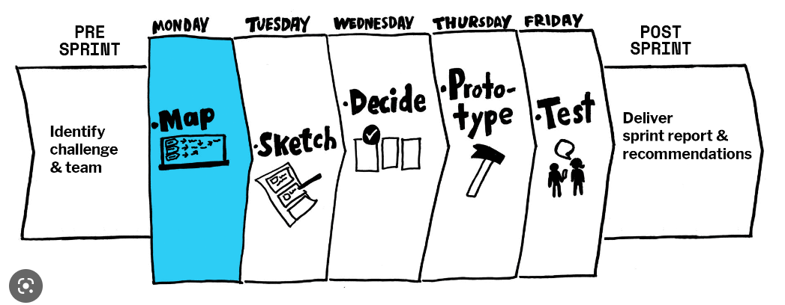
Day 1
Guideline video on what to do to set the stage
Guidelines video for day 1
Checklist for Day 1

Slide 7
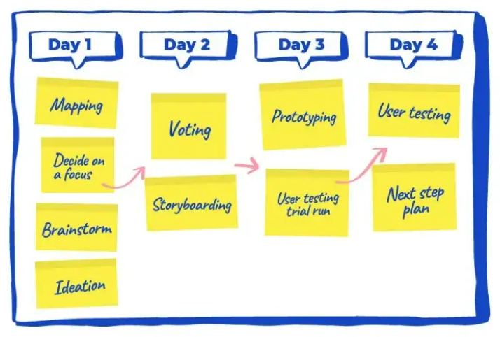
Days and Steps
The first day of the Design Sprint is all about defining the challenge and producing solutions.
Define the long term goal
Expert Interview (Key expert)
User Journey Map
15 minutes lightning demo (direct and indirect solution by competition)

Slide 8
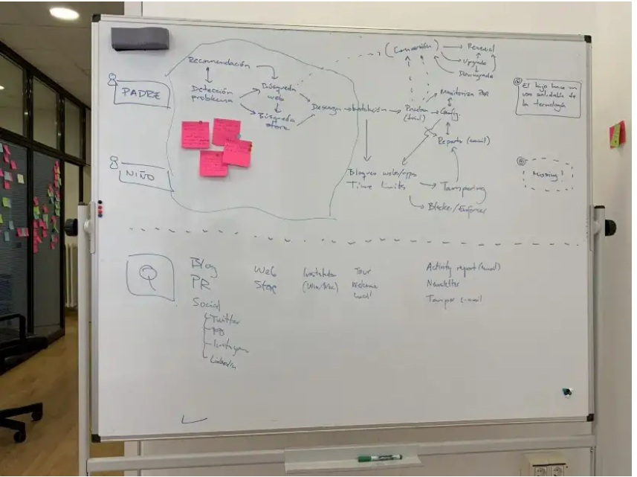
Map

